Slide 1
DESIGN

Slide 2
Purpose of Design
Design is where customer requirements, business needs, and technical considerations all come together in the formulation of a product or system
The design model provides detail about the software data structures, architecture, interfaces, and components
The design model can be assessed for quality and be improved before code is generated and tests are conducted
(More on next slide)

Slide 3
Purpose of Design
  Does the design contain errors, inconsistencies, or omissions?
  Are there better design alternatives?
  Can the design be implemented within the constraints, schedule, and cost that has been established?

Slide 4
Purpose of Design (continued)
A designer must practice diversification and convergence
  The designer selects from design components, component solutions, and knowledge available through catalogs, textbooks, and experience
  The designer then chooses the elements from this collection that meet the requirements defined by requirements engineering and analysis modeling
  Convergence occurs as alternatives are considered and rejected until one particular configuration of components is chosen

Slide 5
Purpose of Design (continued)
Software design is an iterative process through which requirements are translated into a blueprint for constructing the software
  Design begins at a high level of abstraction that can be directly traced back to the data, functional, and behavioral requirements
  As design iteration occurs, subsequent refinement leads to design representations at much lower levels of abstraction

Slide 6
From Analysis Model to
Design Model
Each element of the analysis model provides information that is necessary to create the four design models
  The data/class design transforms analysis classes into design classes along with the data structures required to implement the software
  The architectural design defines the relationship between major structural elements of the software; architectural styles and design patterns help achieve the requirements defined for the system
(More on next slide)

Slide 7
From Analysis Model to
Design Model
  The interface design describes how the software communicates with systems that interoperate with it and with humans that use it
  The component-level design transforms structural elements of the software architecture into a procedural description of software components

Slide 8
From Analysis Model to
Design Model (continued)
Component-level Design
(Class-based model, Flow-oriented model
Behavioral model)
Interface Design
(Scenario-based model, Flow-oriented model
Behavioral model)
Architectural Design
(Class-based model, Flow-oriented model)
Data/Class Design
(Class-based model, Behavioral model)

Slide 9
Task Set for Software Design
Examine the information domain model and design appropriate data structures for data objects and their attributes
Using the analysis model, select an architectural style (and design patterns) that are appropriate for the software
Partition the analysis model into design subsystems and allocate these subsystems within the architecture
  Design the subsystem interfaces
  Allocate analysis classes or functions to each subsystem
(More on next slide)

Slide 10
Task Set for Software Design
4) Create a set of design classes or components
  Translate each analysis class description into a design class
  Check each design class against design criteria; consider inheritance issues
  Define methods associated with each design class
  Evaluate and select design patterns for a design class or subsystem

Slide 11
Task Set for Software Design (continued)
Design any interface required with external systems or devices
Design the user interface
Conduct component-level design
  Specify all algorithms at a relatively low level of abstraction
  Refine the interface of each component

Slide 12
Task Set for Software Design (continued)
  Define component-level data structures
  Review each component and correct all errors uncovered
Develop a deployment model
  Show a physical layout of the system, revealing which components will be located where in the physical computing environment

Slide 13
Design Quality
The importance of design is quality
Design is the place where quality is fostered
  Provides representations of software that can be assessed for quality
  Accurately translates a customer's requirements into a finished software product or system
  Serves as the foundation for all software engineering activities that follow

Slide 14
Design Quality
Without design, we risk building an unstable system that
  Will fail when small changes are made
  May be difficult to test
  Cannot be assessed for quality later in the software process when time is short and most of the budget has been spent
The quality of the design is assessed through a series of formal technical reviews or design walkthroughs

Slide 15
Goals of a Good Design
The design must implement all of the explicit requirements contained in the analysis model
  It must also accommodate all of the implicit requirements desired by the customer
The design must be a readable and understandable guide for those who generate code, and for those who test and support the software
The design should provide a complete picture of the software, addressing the data, functional, and behavioral domains from an implement perspective
"Writing a clever piece of code that works is one thing; designing something
that can support a long-lasting business is quite another."

Slide 16
Design Quality Guidelines
A design should exhibit an architecture that
  Has been created using recognizable architectural styles or patterns
  Is composed of components that exhibit good design characteristics
  Can be implemented in an evolutionary fashion, thereby facilitating implementation and testing
(more on next slide)

Slide 17
Design Quality Guidelines
A design should be modular; that is, the software should be logically partitioned into elements or subsystems
A design should contain distinct representations of data, architecture, interfaces, and components
A design should lead to data structures that are appropriate for the classes to be implemented and are drawn from recognizable data patterns

Slide 18
Quality Guidelines (continued)
A design should lead to components that exhibit independent functional characteristics
A design should lead to interfaces that reduce the complexity of connections between components and with the external environment
A design should be derived using a repeatable method that is driven by information obtained during software requirements analysis
A design should be represented using a notation that effectively communicates its meaning
"Quality isn't something you lay on top of subjects and objects
like tinsel on a Christmas tree."

Slide 19
Design Concepts
Abstraction
  Procedural abstraction – a sequence of instructions that have a specific and limited function
  Data abstraction – a named collection of data that describes a data object
Architecture
  The overall structure of the software and the ways in which the structure provides conceptual integrity for a system
  Consists of components, connectors, and the relationship between them
(more on next slide)

Slide 20
Design Concepts
Patterns
  A design structure that solves a particular design problem within a specific context
  It provides a description that enables a designer to determine whether the pattern is applicable, whether the pattern can be reused, and whether the pattern can serve as a guide for developing similar patterns
Modularity
  Separately named and addressable components (i.e., modules) that are integrated to satisfy requirements (divide and conquer principle)
  Makes software intellectually manageable so as to grasp the control paths, span of reference, number of variables, and overall complexity

Slide 21
Design Concepts (continued)
Information hiding
  The designing of modules so that the algorithms and local data contained within them are inaccessible to other modules
  This enforces access constraints to both procedural (i.e., implementation) detail and local data structures
Functional independence
  Modules that have a "single-minded" function and an aversion to excessive interaction with other modules
  High cohesion – a module performs only a single task
  Low coupling – a module has the lowest amount of connection needed with other modules
(more on next slide)

Slide 22
Design Concepts (continued)
Stepwise refinement
  Development of a program by successively refining levels of procedure detail
  Complements abstraction, which enables a designer to specify procedure and data and yet suppress low-level details
Refactoring
  A reorganization technique that simplifies the design (or internal code structure) of a component without changing its function or external behavior
  Removes redundancy, unused design elements, inefficient or unnecessary algorithms, poorly constructed or inappropriate data structures, or any other design failures

Slide 23
Design Concepts (continued)
Design classes
  Refines the analysis classes by providing design detail that will enable the classes to be implemented
  Creates a new set of design classes that implement a software infrastructure to support the business solution

Slide 24
Types of Design Classes
User interface classes – define all abstractions necessary for human-computer interaction (usually via metaphors of real-world objects)
Business domain classes – refined from analysis classes; identify attributes and services (methods) that are required to implement some element of the business domain
Process classes – implement lower-level business abstractions required to fully manage the business domain classes

Slide 25
Types of Design Classes
Persistent classes – represent data stores (e.g., a database) that will persist beyond the execution of the software
System classes – implement software management and control functions that enable the system to operate and communicate within its computing environment and the outside world

Slide 26
Characteristics of a Well-Formed Design Class
Complete and sufficient
  Contains the complete encapsulation of all attributes and methods that exist for the class
  Contains only those methods that are sufficient to achieve the intent of the class
Primitiveness
  Each method of a class focuses on accomplishing one service for the class
  Each class should have limited knowledge of other classes in other subsystems

Slide 27
Characteristics of a Well-Formed Design Class
High cohesion
  The class has a small, focused set of responsibilities and single-mindedly applies attributes and methods to implement those responsibilities
Low coupling
  Collaboration of the class with other classes is kept to an acceptable minimum

Slide 28
The Design Model
Component-level Design
Interface Design
Architectural Design
Data/Class Design

Slide 29
Dimensions of the Design Model
High
Analysis model
Abstraction Dimension
Design model
Data/Class
Elements
Architectural
Elements
Interface
Elements
Component-level
Elements
Deployment-level
Elements
Low
Process Dimension (Progression)

Slide 30
Design Model
The design model can be viewed in two different dimensions
  (Horizontally) The process dimension indicates the evolution of the parts of the design model as each design task is executed
  (Vertically) The abstraction dimension represents the level of detail as each element of the analysis model is transformed into the design model and then iteratively refined
Elements of the design model use many of the same UML diagrams used in the analysis model
  The diagrams are refined and elaborated as part of the design
(More on next slide)

Slide 31
Design Model
  More implementation-specific detail is provided
  Emphasis is placed on
    Architectural structure and style
    Interfaces between components and the outside world
    Components that reside within the architecture
Design model elements are not always developed in a sequential fashion
  Preliminary architectural design sets the stage
  It is followed by interface design and component-level design, which often occur in parallel

Slide 32
Introduction (continued)
The design model has the following layered elements
  Data/class design
  Architectural design
  Interface design
  Component-level design
A fifth element that follows all of
the others is deployment-level design
Component-level Design
Interface Design
Architectural Design
Data/Class Design

Slide 33
Design Elements
Data/class design
  Creates a model of data that is represented at a high level of abstraction
Architectural design
  Depicts the overall layout of the software
Interface design
  Tells how information flows into and out of the system and how it is communicated among the components defined as part of the architecture
  Includes the user interface, external interfaces, and internal interfaces

Slide 34
Design Elements
Component-level design elements
  Describes the internal detail of each software component by way of data structure definitions, algorithms, and interface specifications
Deployment-level design elements
  Indicates how software functionality and subsystems will be allocated within the physical computing environment that will support the software

Slide 35
Pattern-based Software Design
Mature engineering disciplines make use of thousands of design patterns for such things as buildings, highways, electrical circuits, factories, weapon systems, vehicles, and computers
Design patterns also serve a purpose in software engineering
Architectural patterns
  Define the overall structure of software
  Indicate the relationships among subsystems and software components
  Define the rules for specifying relationships among software elements
☺

Slide 36
Pattern-based Software Design
Design patterns
  Address a specific element of the design such as an aggregation of components or solve some design problem, relationships among components, or the mechanisms for effecting inter-component communication
  Consist of creational, structural, and behavioral patterns
Coding patterns
  Describe language-specific patterns that implement an algorithmic or data structure element of a component, a specific interface protocol, or a mechanism for communication among components

Slide 37
Architectural Design
The design process for identifying the sub-systems making up a system and the framework for sub-system control and communication is architectural design.
The output of this design process is a description of the software architecture

Slide 38
Architectural Design
An early stage of the system design process.
Represents the link between specification and design processes.
Often carried out in parallel with some specification activities.
It involves identifying major system components and their communications

Slide 39
Advantages of explicit architecture
Stakeholder communication
  Architecture may be used as a focus of discussion by system stakeholders.
System analysis
  Means that analysis of whether the system can meet its non-functional requirements is possible.
Large-scale reuse
  The architecture may be reusable across a range of systems.

Slide 40
Architecture and system characteristics
Performance
  Localise critical operations and minimise communications. Use large rather than fine-grain components.
Security
  Use a layered architecture with critical assets in the inner layers.
Safety
  Localise safety-critical features in a small number of sub-systems.
Availability
  Include redundant components and mechanisms for fault tolerance.
Maintainability
  Use fine-grain, replaceable components

Slide 41
System structuring
Concerned with decomposing the system into interacting sub-systems.
The architectural design is normally expressed as a block diagram presenting an overview of the system structure.
More specific models showing how sub-systems share data, are distributed and interface with each other may also be developed.

Slide 42
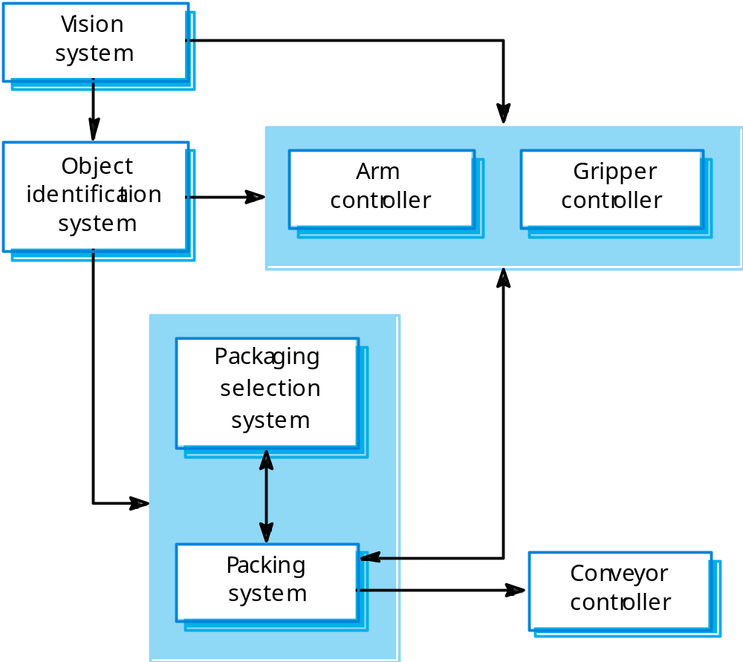
Packing robot control system

Slide 43
Box and line diagrams
Very abstract - they do not show the nature of component relationships nor the externally visible properties of the sub-systems.
However, useful for communication with stakeholders and for project planning.

Slide 44
User Interface Design
User interfaces should be designed to match the skills, experience and expectations of its anticipated users.
System users often judge a system by its
interface rather than its functionality.
A poorly designed interface can cause a user to make catastrophic errors.
Poor user interface design is the reason why so many software systems are never used.

Slide 45
Human factors in interface design
Limited short-term memory
  People can instantaneously remember about 7 items of information. If you present more than this, they are more liable to make mistakes.
People make mistakes
  When people make mistakes and systems go wrong, inappropriate alarms and messages can increase stress and hence the likelihood of more mistakes.
People are different
  People have a wide range of physical capabilities. Designers should not just design for their own capabilities.
People have different interaction preferences
  Some like pictures, some like text.

Slide 46
UI design principles
UI design must take account of the needs, experience and capabilities of the system users.
Designers should be aware of people’s physical and mental limitations (e.g. limited short-term memory) and should recognise that people make mistakes.
UI design principles underlie interface designs although not all principles are applicable to all designs.

Slide 47
User interface design principles
User familiarity
  The interface should be based on user-oriented
  terms and concepts rather than computer concepts. For example, an office system should use concepts such as letters, documents, folders etc. rather than directories, file identifiers, etc.
Consistency
  The system should display an appropriate level
  of consistency. Commands and menus should have the same format, command punctuation should be similar, etc.
Minimal surprise
  If a command operates in a known way, the user should be
  able to predict the operation of comparable commands

Slide 48
User interface design principles
Recoverability
  The system should provide some resilience to
  user errors and allow the user to recover from errors. This might include an undo facility, confirmation of destructive actions, 'soft' deletes, etc.
User guidance
  Some user guidance such as help systems, on-line manuals, etc. should be supplied
User diversity
  Interaction facilities for different types of user should be supported. For example, some users have seeing difficulties and so larger text should be available

Slide 49
Interaction styles
Direct manipulation
Menu selection
Form fill-in
Command language
Natural language

Slide 50
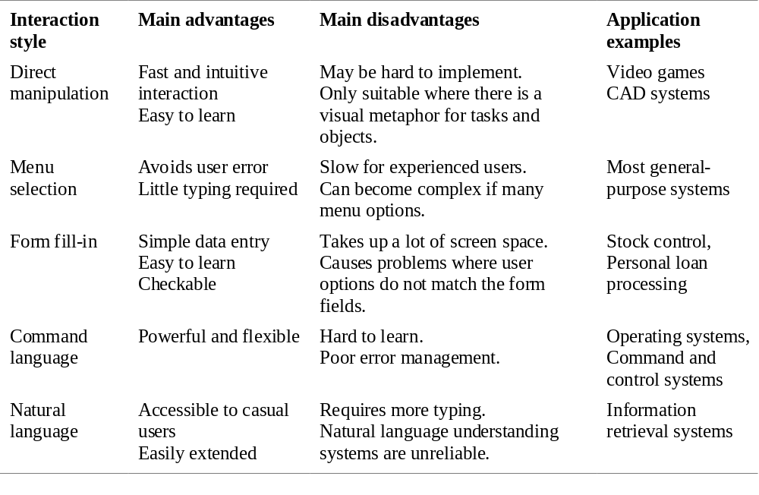
Interaction Styles

